Slide 1
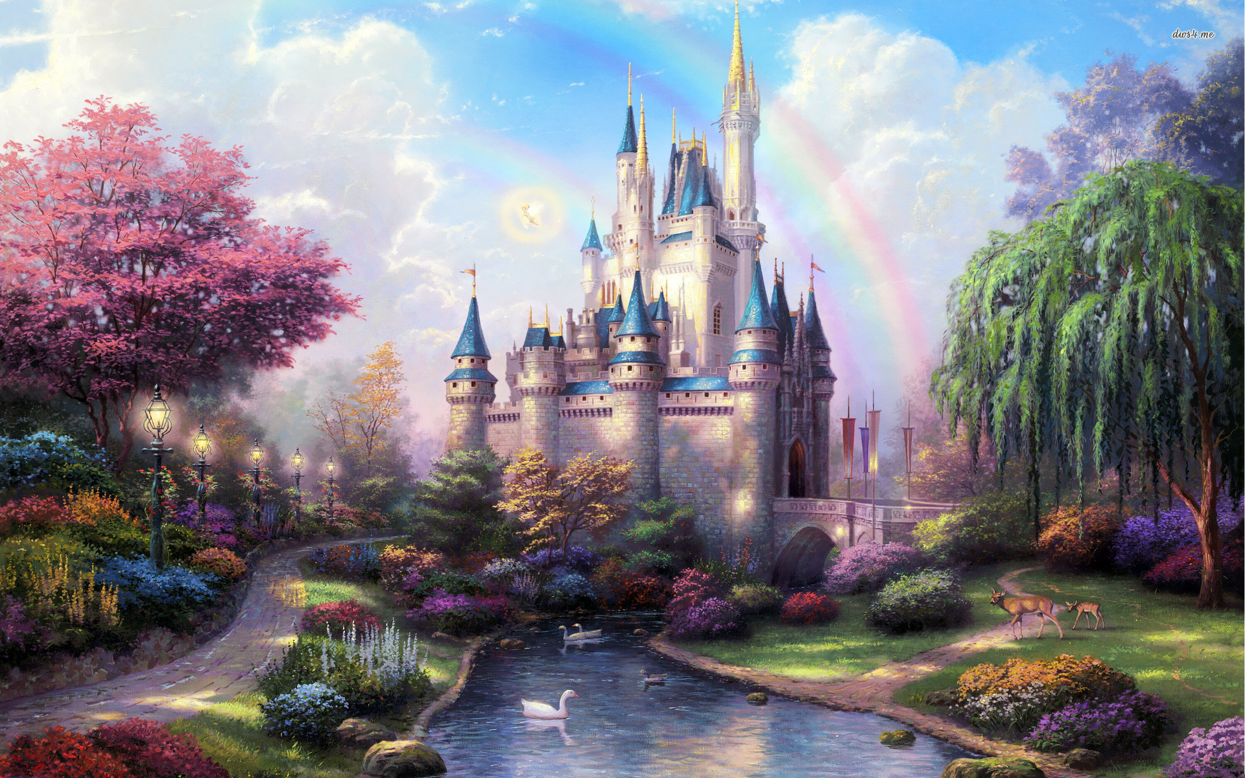
Once upon a time…

Slide 2
There was a girl who lived in a castle…
…but she was unhappy

Slide 3
Sometimes she walked even for couple of hours.

Slide 4
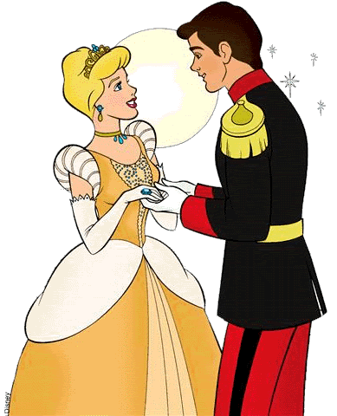
One day she met a perfect guy…

Slide 5
And they lived happily ever after !

